Slide 1
Zomato Data Analysis Project
By : Anas Aamer
In this project where we analyze Zomato's data to uncover valuable insights and trends. In which we use the pythons and it’s libraries like numpy , pandas , plt and seaborn to make the
visualization.

Slide 2
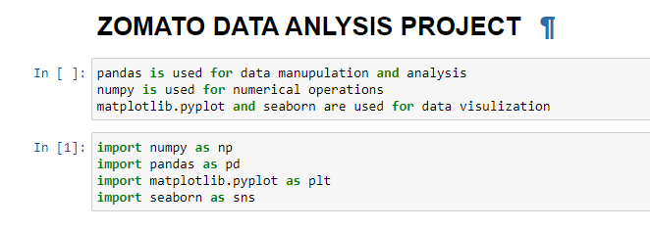
Import the important libraries

Slide 3
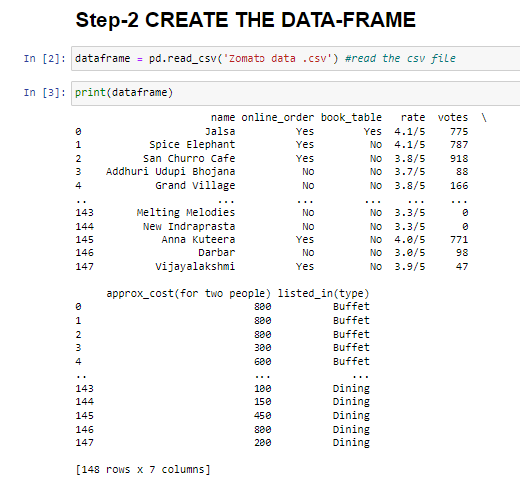
To create and read the file

Slide 4
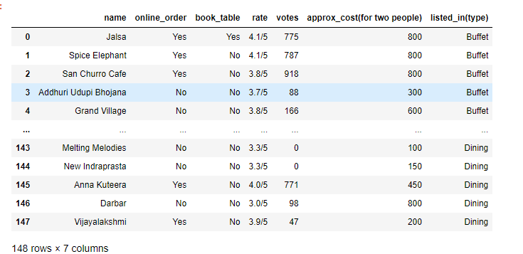
Data - Frame

Slide 5
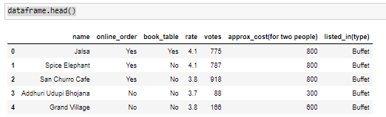
Wash the data - frame

Slide 6
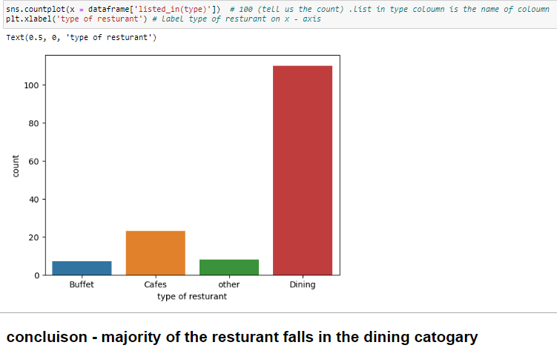
1) What type of restaurant do the majority of customers order from?

Slide 7
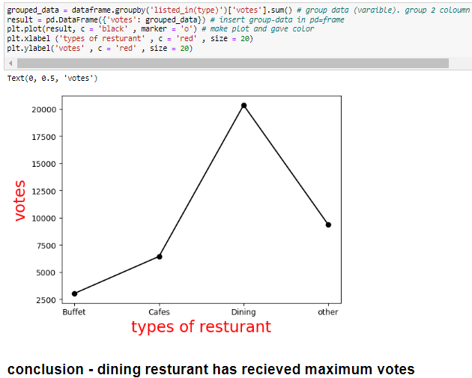
2) How many votes has each type of restaurant have received?

Slide 8
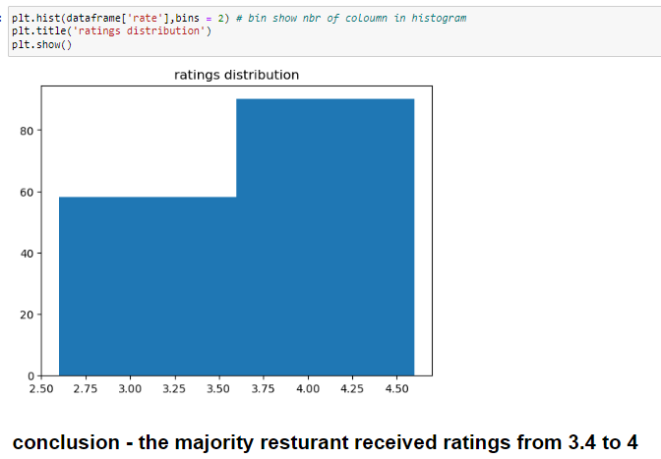
3) What are the ratings that the majority of restaurant have received?

Slide 9
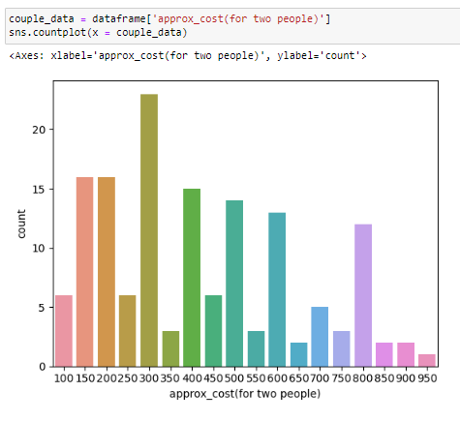
4) Zomato has observed that the most couples order most of their food online. What is their average spending on each order?

Slide 10
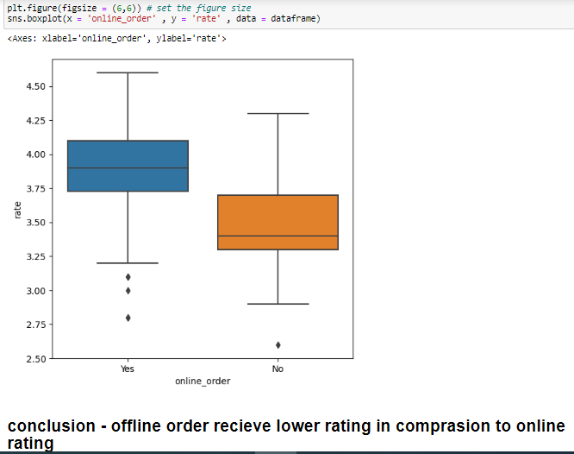
5) Which mode (online or offline) has that maximum rating?

